Slide 1
Key Masters Midterm Presentation
Hannah Protzman, Jeremiah White, Kyle Warren, Cassie Baldus, Peyton Mizera

Slide 2
Introduction
Recap the project
Client
Why it’s important?
Main objective
Hannah

Slide 3
Requirements
Jeremiah

Slide 4
Demo
Show the app (form)
Walk through hypothetical user
Kyle

Slide 5
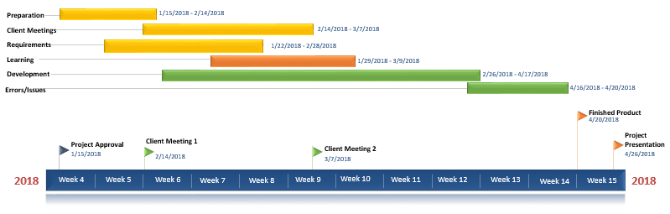
Timeline
Cassie

Slide 6
Challenges Faced/Risks
Peyton

Slide 7
Technologies Being Used
Jeremiah

Slide 8
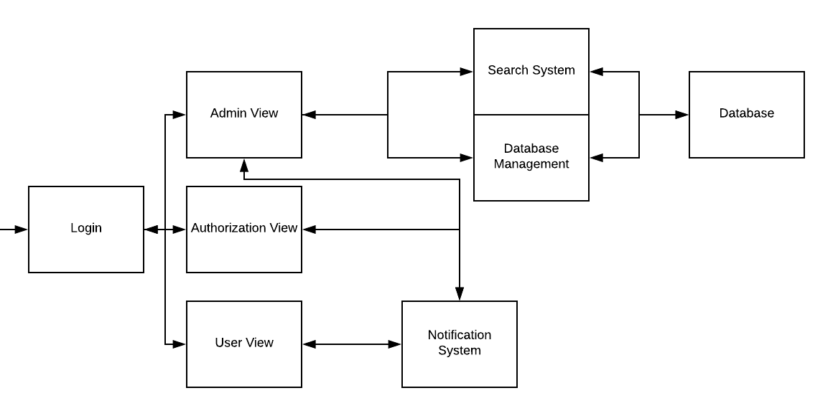
UML Architecture
Kyle

Slide 9
Client comments
(Jeremiah, can you tell us some things they said?)
Cassie

Slide 10
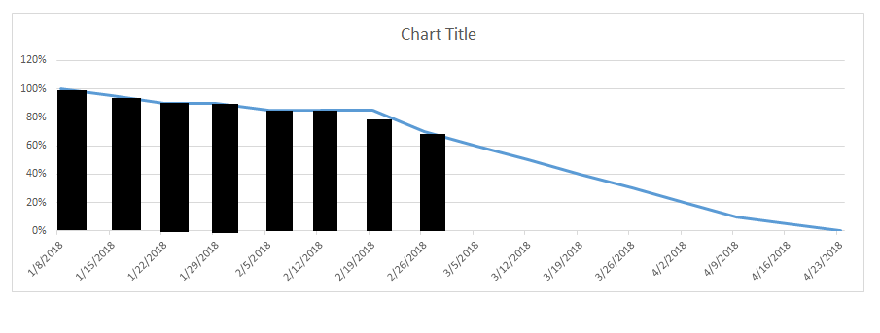
Burn down chart

Slide 11
Overall Assessment
To Date: ~30% done
Weekly meetings
Learned
Hannah

